Slide 1
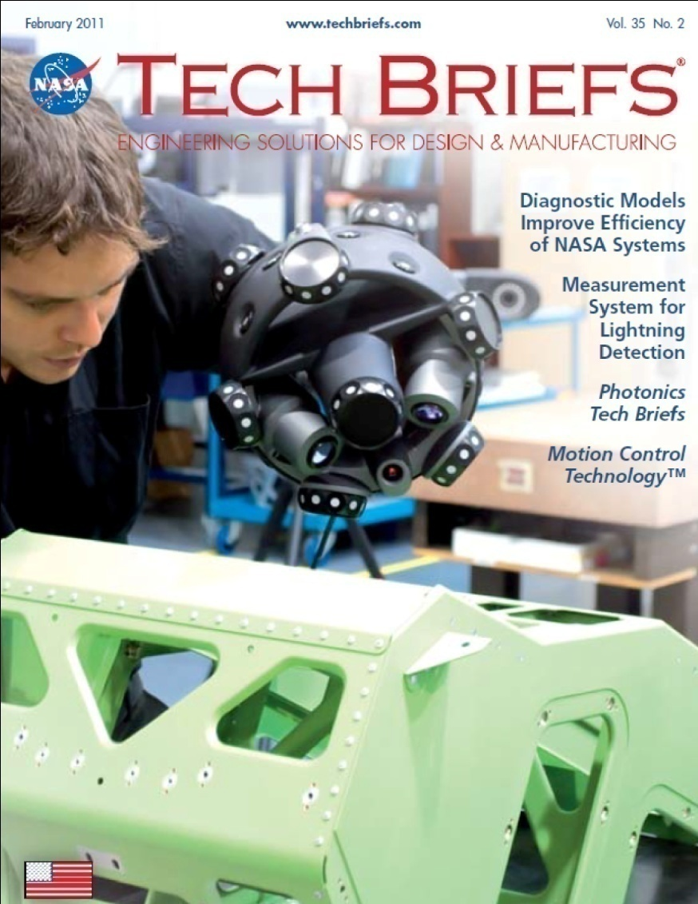

New Product Presentation:
Creaform’s MetraSCAN
March 8th 2011
Daniel Brown
Product Manager

Slide 2
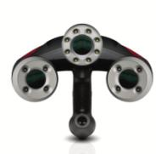
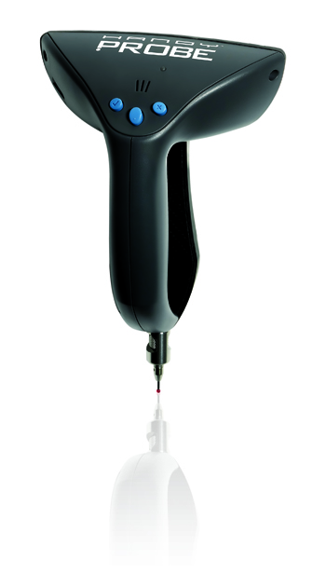
MetraSCAN Presentation
A little bit of background…
2005. The Handyscan 3D is the undisputed reference for truly portable accurate 3D scanning
2009. The HandyPROBE optical CMMs have set the bar higher among hard probing portable CMM!
2010…Creaform aims at materializing its vision to provide metrologists with an accurate and fully integrated measurement solution, adapted for repetitive inspection next to the production line…

Slide 4
Filling the Gap in Metrology
MetraSCAN:
The 3Dscanner for dimensional measurement
The MetraSCAN is what metrologists want:
  Complete solution
  Easy to learn
  But most importantly, it delivers the quality needed by the most demanding industries (auto, aero, ...)
MetraSCAN is the most accurate solution for shop floor applications and metrology lab inspection.

Slide 5
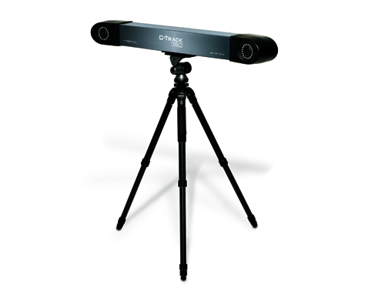
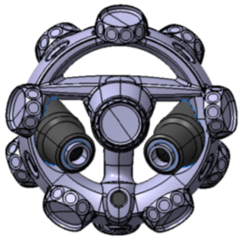
MetraSCAN: Technology & Design
Technology
  Optical CMM 3D Scanner
  TRUaccuracyTM Technology
Design
  For maximum target localization (360 degrees)
  Rigid carbon design to ensure accurate target positioning

Slide 6

Let’s see it in action!

Slide 7
MetraSCAN Key Benefits
The Most Accurate Measurement Solution
  Scanning and probing accuracy of
  0.085mm (0.0033in)
Featuring TRUaccuracyTM
  Optical technology developed by Creaform’s R&D that ensures accuracy regardless of measurement environment, user experience or setup quality
  Features several functions:
    Dynamic Referencing
    Automatic Alignment
    User Calibration
    Continuous Parameter Monitoring

Slide 8
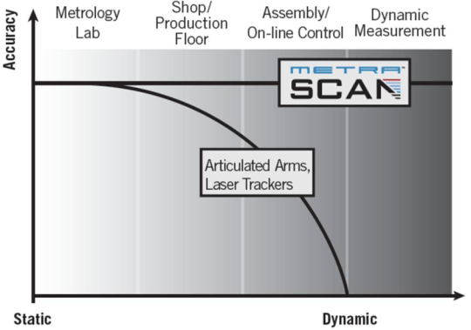
TRUaccuracyTM
Using the TRUaccuracy algorithms, the MetraSCAN
delivers the best accuracy in all conditions!

Slide 9
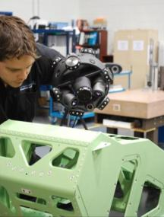
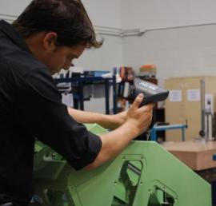
MetraSCAN Key Benefits
Complete and Powerful Inspection Solution
  Geometrical and freeform inspection on the same part with the same system
  Allows efficient repetitive inspections

Slide 10
MetraSCAN Key Benefits
Faster and Easier Measurement
  Quick setup and measurement.
  Full freedom of movement and no mechanical link.
  Surface & feature inspection using the same system.
  Complete inspection with one system.

Slide 11
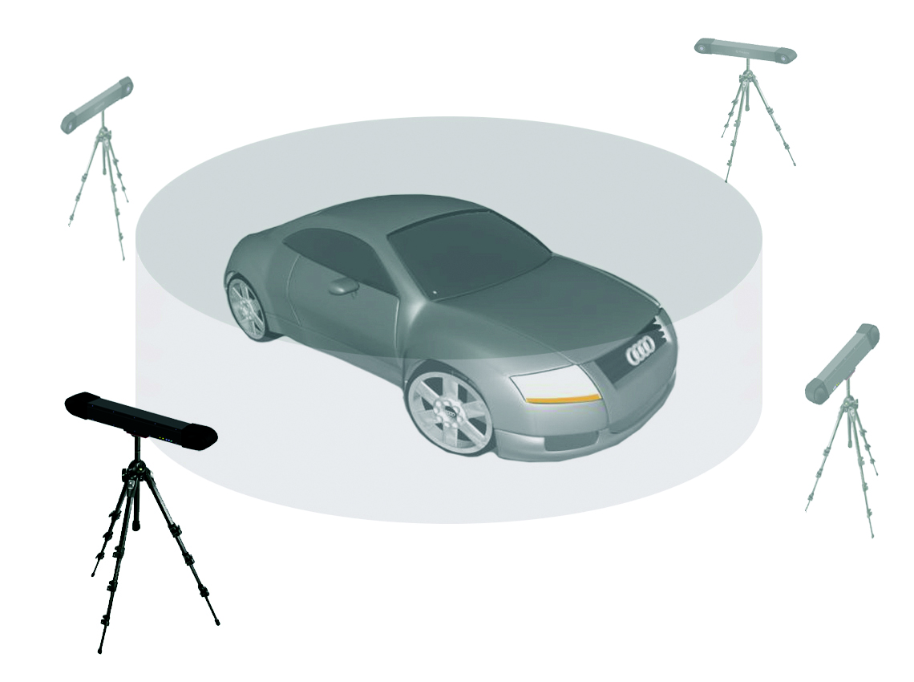
MetraSCAN Key Benefits
Greater, Extendable Measurement Volume
Portable Device
Affordable

Slide 12
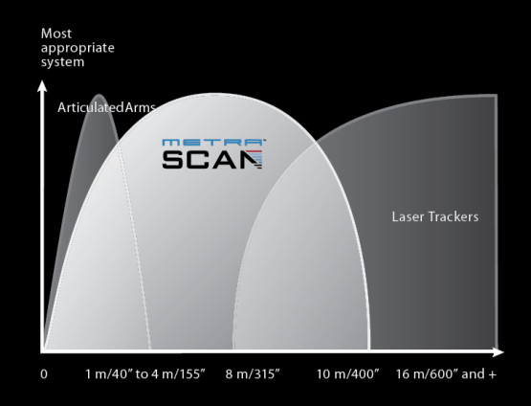
MetraSCAN in Metrology
Closing the Gap

Slide 13
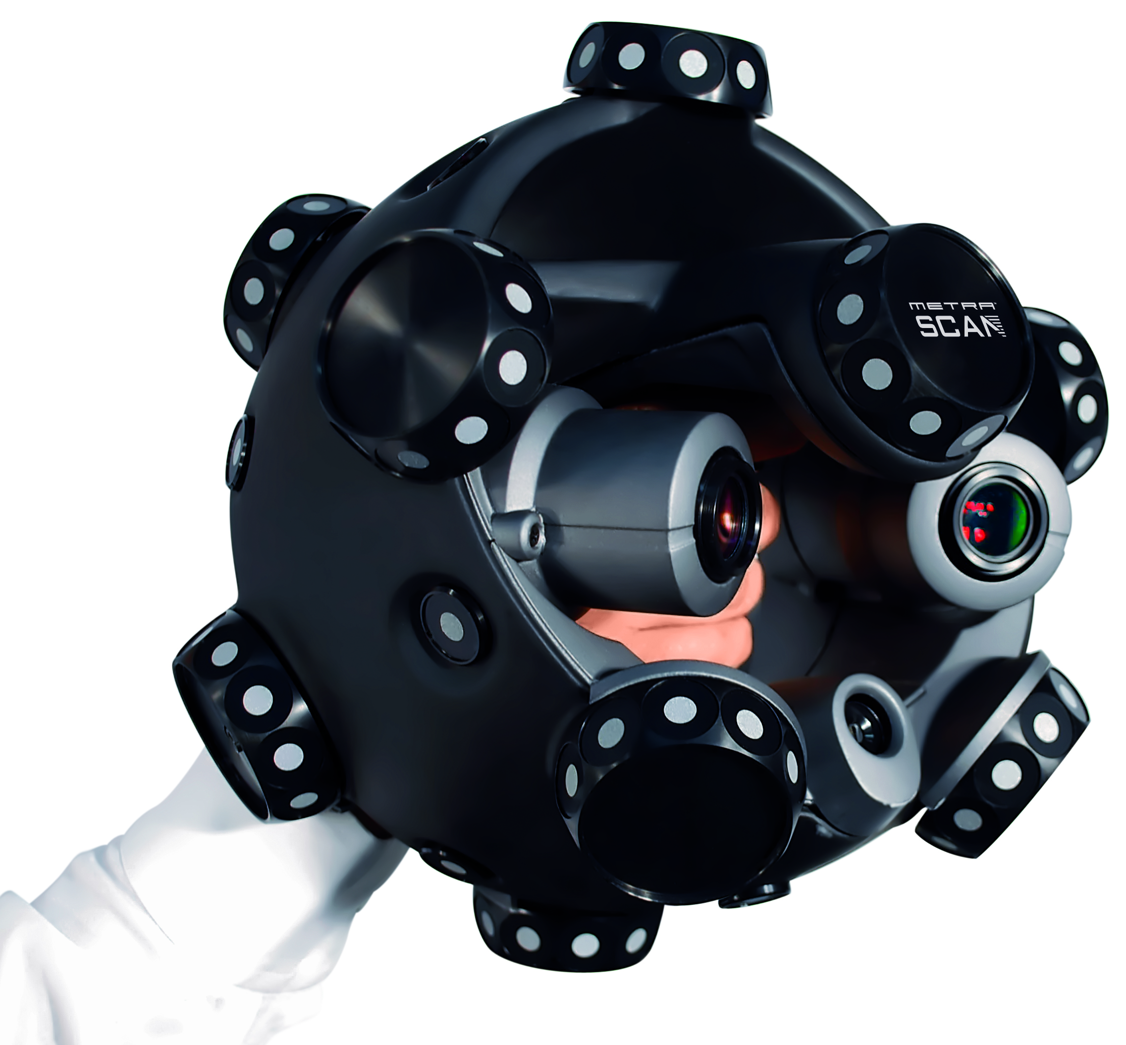
MetraSCAN with HandyPROBE
HandyPROBE
  A HandyPROBE is needed to use the MetraSCAN.
  The HandyPROBE is part of the MetraSCAN solution.
  Together, they deliver the most complete and accurate inspection solution.
The most complete
and accurate solution
for inspection

Slide 14
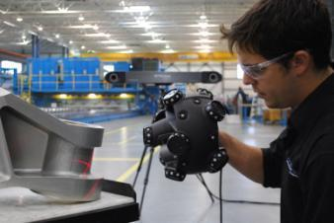
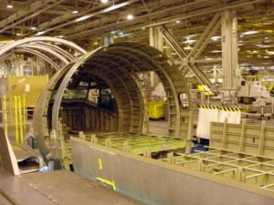
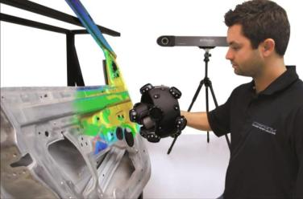
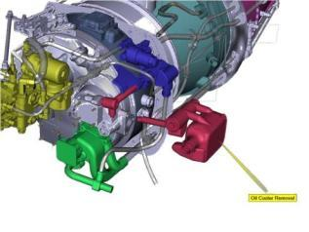
MetraSCAN
Applications

Slide 15
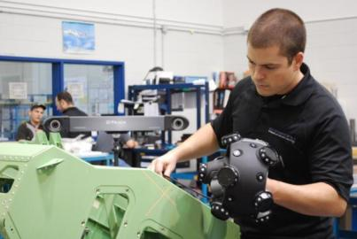
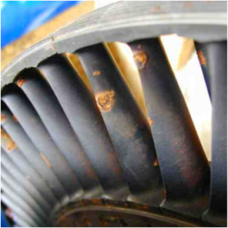
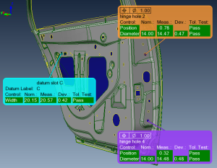
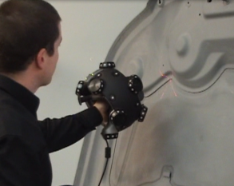
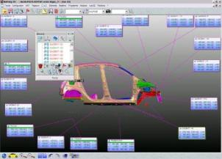
MetraSCAN Applications
First Article Inspection
Tool Testing and Adjustments
Repetitive Inspections on the Production Floor
Flush & Gap Analysis
Maintenance
Assisted Assembly
Advantages
  Complete inspection with scanning and probing
  High-density measurement
  Dynamic referencing: allows other service work during 3D measurement
  Quick setup and measurement
  Automatic alignment for part inspection on jigs
  Less sensitive to shiny surfaces.

Slide 16
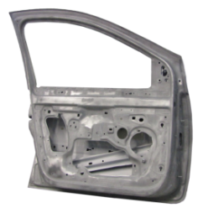
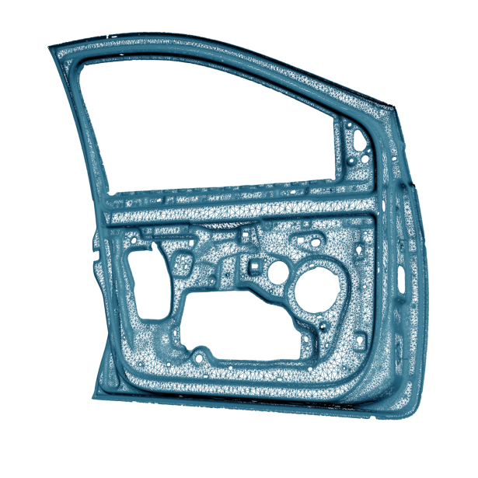
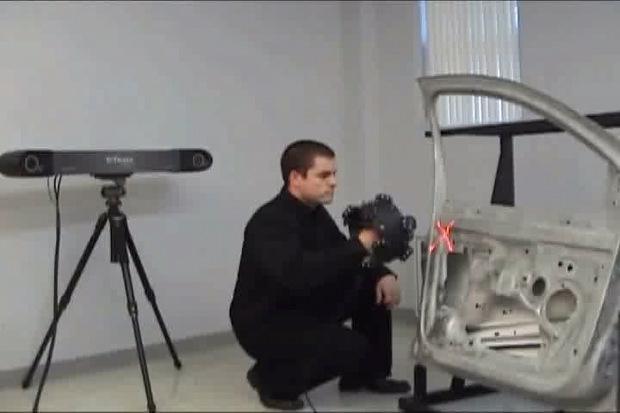
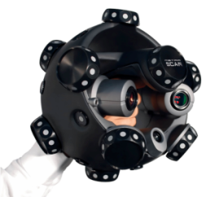
MetraSCAN
Application
Example

Slide 17
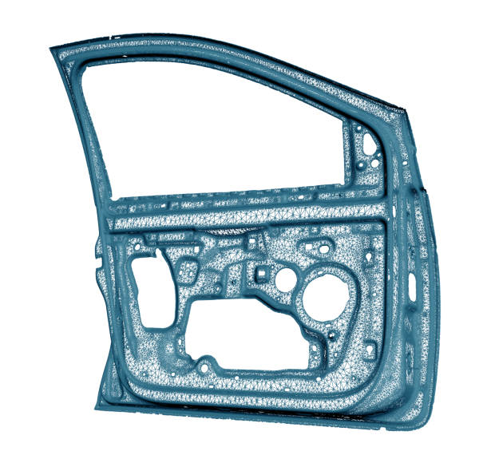
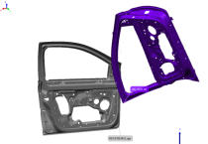
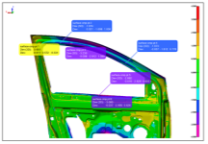
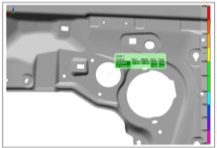
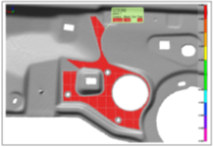
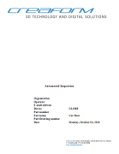
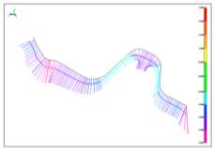
Inspection Process
Alignment
Color Map
Holes & Flatness
Report
Section Deviation

Slide 18
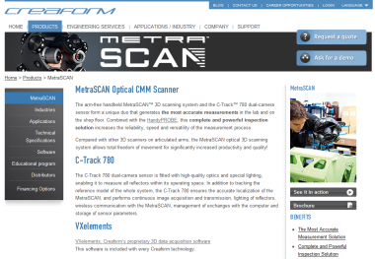
MetraSCAN
More Info?
Visit our website:
  Technology description
  Brochure
  In action Video
  Request a quote!
  Ask for a demo!
www.creaform3d.com

Slide 19
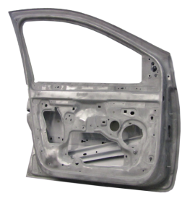
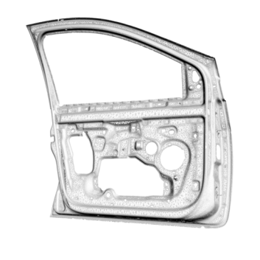
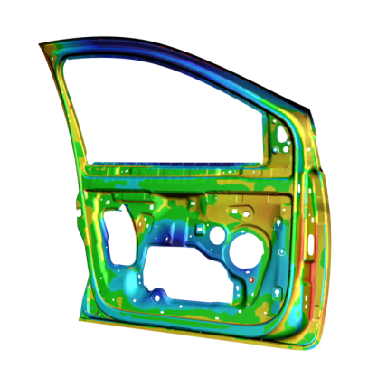

Questions?

